Slide 1


Portfolio Substitution between Coastal Pelagic Species under Shifting Target Species Distributions and Policy Constraints
Felipe J. Quezada
UC Santa Cruz
NOAA Southwest Fisheries Science Center
Co-authors: Desiree Tommasi (UCSC & NOAA SWFSC), Stephen Stohs (NOAA SWFSC), Isaac Kaplan (NOAA NWFSC), Jonathan Sweeney (NOAA PIFSC), Barbara Muhling (UCSC & NOAA SWFSC), Tim Frawley (UCSC & NOAA SWFSC)
January 6th, 2022
Notes:
Relative prices between species?
Include income diversification as a variable.
Low prices, spikes in landings… weird incentives behind. Prices to low. Maybe not relevant
Squid if substitute for sardine, why decrease when sardine close?
How easy a vessel changes between species (or between gears)

Slide 2
How will climate change impact fishing communities?
Specific questions:
How changes in species distribution and regulations (i.e. closures) will affect vessel's participation and landings in the Coastal Pelagic Species (CPS) fishery?
Hurdle model for landings and participation by vessels:
Hurdle model:
Probit: Vessel participation in particular fishery during a year/quarter/month.
Lognormal: Level of landings conditional on participation.
Separate models for each species: Squid, Sardine.
Working on individual data (PacFIN)

Slide 3
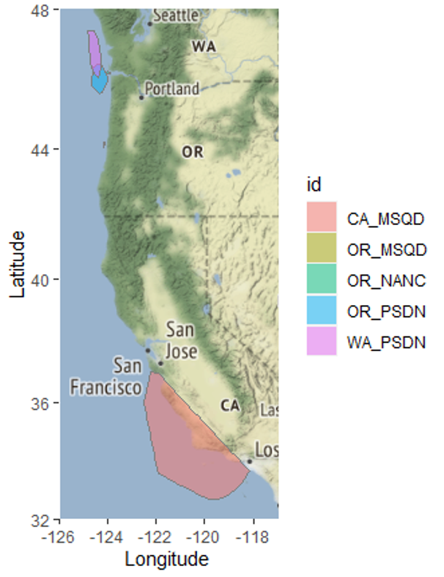
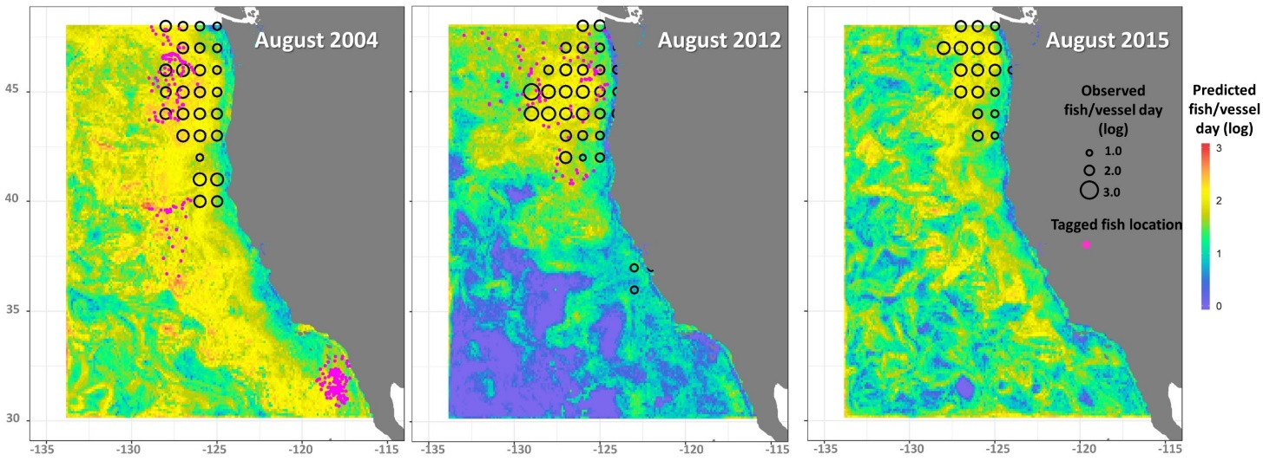
SDMs link to Landings
SDMs outputs for sardine, anchovy, market squid, chub and jack mackerel, herring (Muhling et al. 2019, 2020, Brodie et al. 2021)
We use distance to port to construct our variable of abundance
Fishery operates close to shore
Mostly undergoing daily trips
Data: Logbooks

Slide 4
Some model considerations
How to choose vessels to include in estimations?
Cutoff point (i.e. revenue)?
They should show substitution between species?
Cluster analysis (Tim Frawley working also on this…)
Cutoff point (i.e. revenue)?
They should have LE permits?
Relative v/s own prices? (same for SDM?)
Based on econ theory?
Squid SDM
With spawning biomass or without??
Frequency of the data?
Annual v/s quarterly (monthly do not run…)

Slide 5
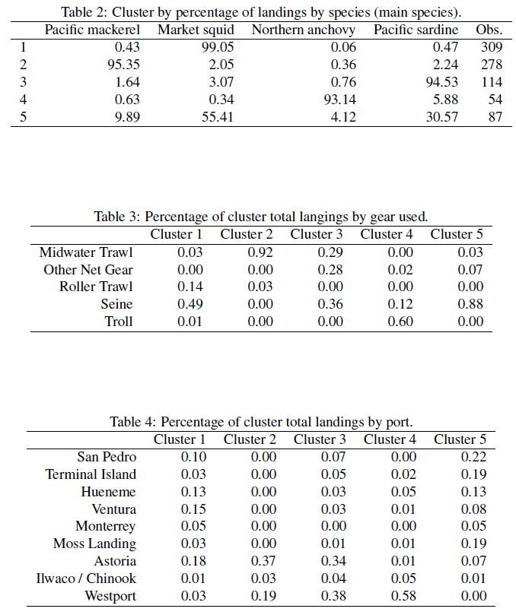
Cluster analysis

Slide 6
Some model considerations
How to choose vessels to include in estimations?
Cutoff point (i.e. revenue)?
They should show substitution between species?
Cluster analysis (Tim Frawley working also on this…)
They should have LE permits?
Relative v/s own prices? (same for SDM?)
Based on econ theory?
Squid SDM
With spawning biomass or without??
Frequency of the data?
Annual v/s quarterly (monthly do not run…)

Slide 7
Thanks for your attention!
Felipe J. Quezada
Postdoctoral Scholar
UC Santa Cruz & NOAA-SWFSC
felipequezada.com
felipe.quezada@noaa.gov

